Slide 1

307307 Part 2 – Introduction to Large Language Models

Slide 2
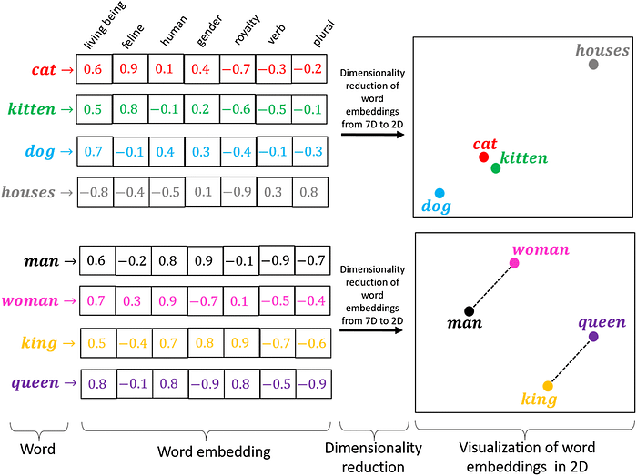
Preface
In the previous section, we used Bow and TDIDF to convert documents and words into numerical representations.
These representations were simple, they had no semantics for words, just on/off switches for existing and non-existing words in a document.
In this part of the course, we want to convert words into meaningful list of numbers.
These numbers are called Word Embeddings.
We will use Neural Networks to create these Word Embeddings.

Slide 3
Introduction to Neural Networks
The Perceptron

Slide 4
Outcomes
Fundamentals of neural networks
Evolution from single perceptrons to MLPs
Detailed MLP architecture (input, hidden, and output layers)
Mathematical representations
Various activation functions (Sigmoid, ReLU, etc.)
Backpropagation and training methodologies
Loss functions and optimization techniques
Architecture design considerations
Real-world applications
Advantages and limitations
Modern MLP variants and implementations

Slide 5
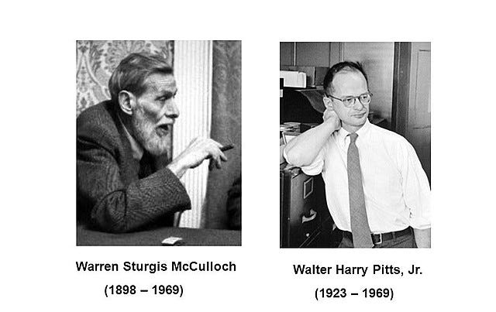
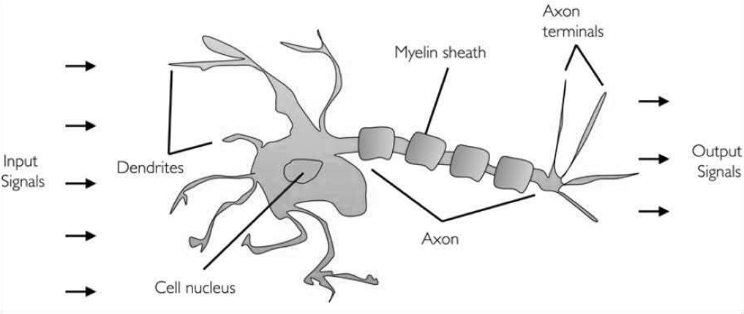
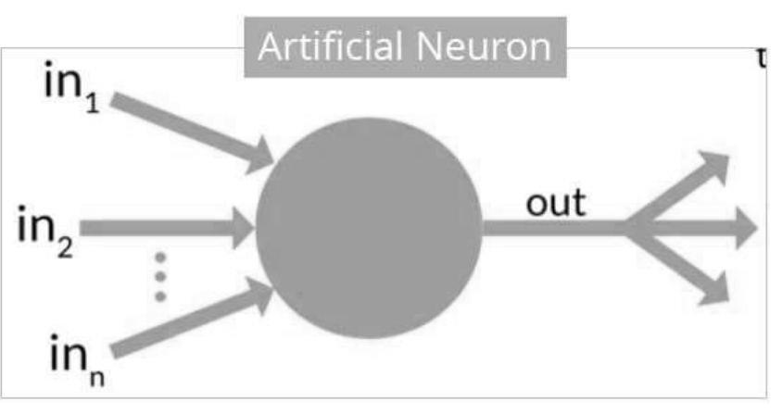
History of Neural Networks
In 1943, researchers Warren McCullock and published their first concept of simplified brain cell.
This was called McCullock-Pitts (MCP) neuron.
They described such a nerve cell as a simple logic gate with binary outputs.
Multiple signals arrive at the dendrites and are then integrated into the cell body, and, if the accumulated signal exceeds a certain threshold, an output signal is generated that will be passed on by the axon.

Slide 6
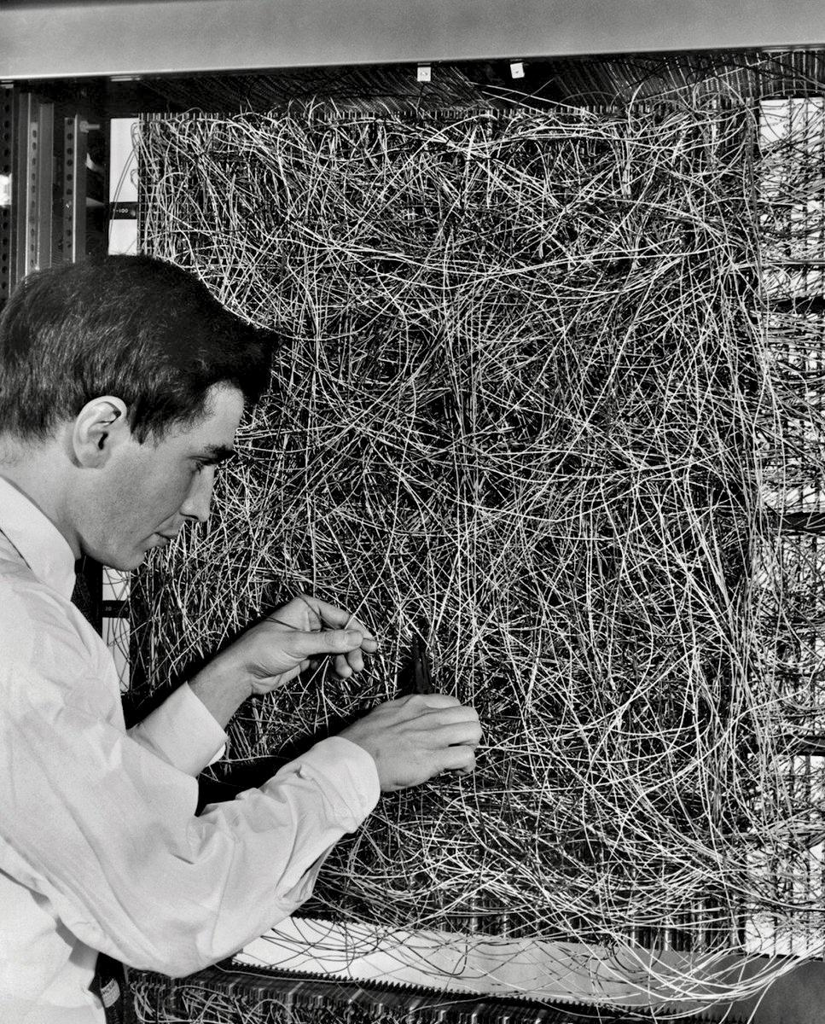
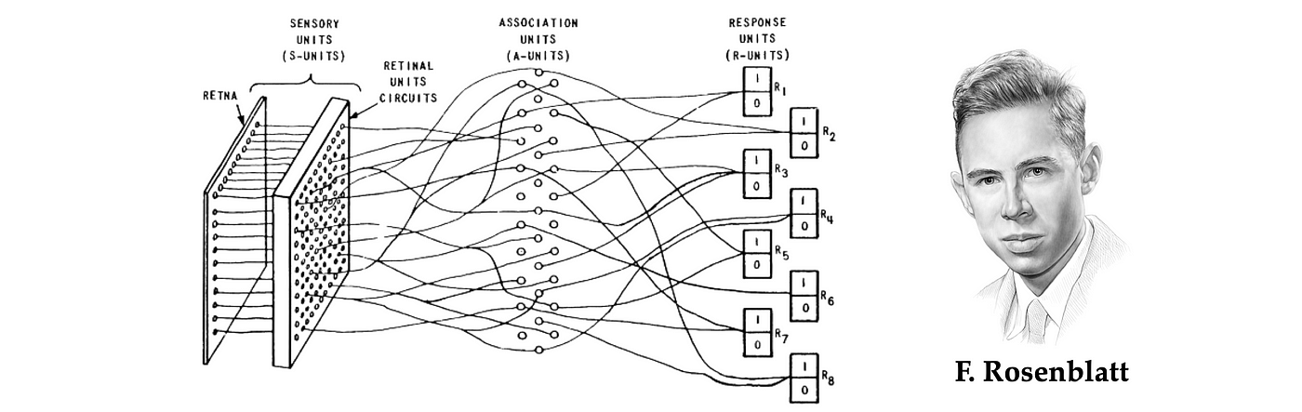
The Perceptron: Building Block of Neural Networks
In 1953, inspired by McCullock work, Frank Rosenblatt invented the Perceptron.
The Perceptron is the simplest form of a neural network
Binary classifier: separates data into two categories
Models a single neuron with multiple inputs and one output

Slide 7
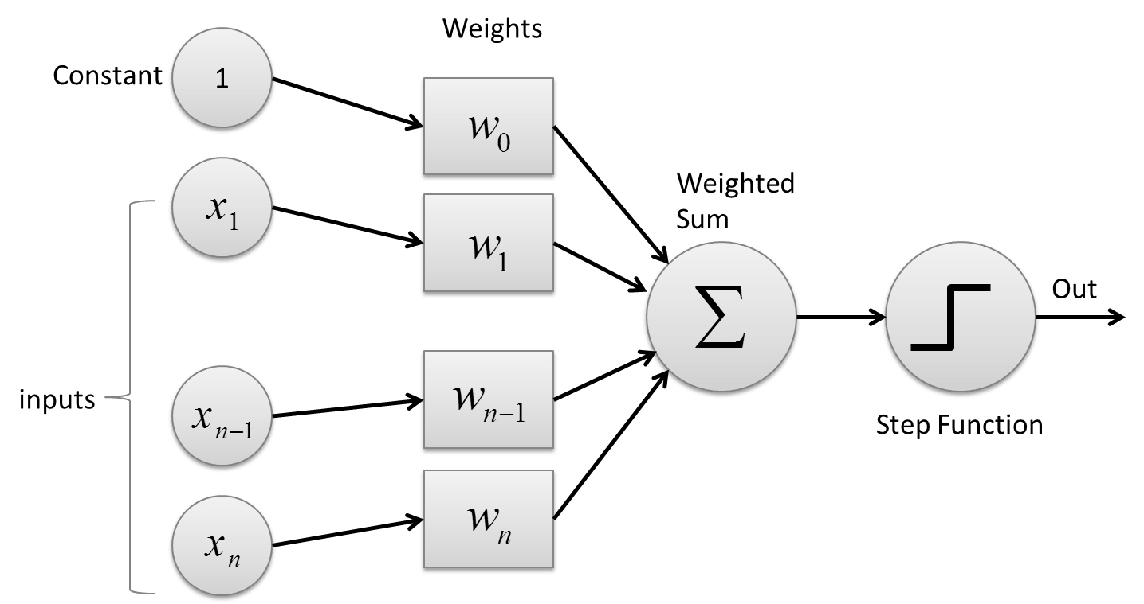
The Perceptron
Inputs: x₁, x₂, ..., xₙ
Weights: w₁, w₂, ..., wₙ
Bias: b
Activation function: Step function
Output: 1 if weighted sum > threshold, 0 otherwise

Slide 8
How a Perceptron Works
Multiply each input by its corresponding weight
Sum all weighted inputs
Add the bias term
Apply the activation function
Output the result
Mathematically:
z = w₁x₁ + w₂x₂ + ... + wₙxₙ + b
output = activation(z)

Slide 9
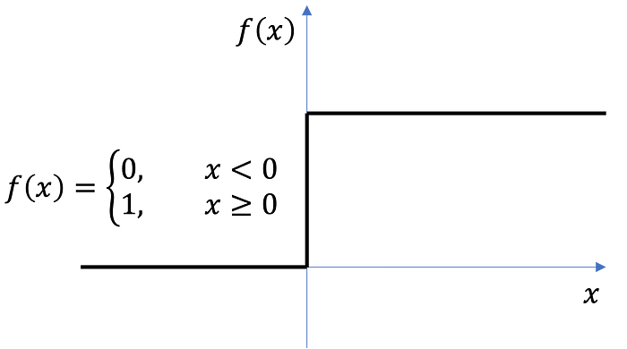
Perceptron Activation Function
Step Function:
Output: 1 if z ≥ 0, 0 if z < 0
Used in original perceptrons
Not differentiable at 0

Slide 10
Perceptron Learning Rule
For each training example:
Calculate predicted output y_pred
Calculate error: error = y_true - y_pred
Update weights: w_new = w_old + learning_rate * error * x
Update bias: b_new = b_old + learning_rate * error

Slide 11
Step-by-Step Hand Calculation for AND Gate
Let's work through the perceptron learning algorithm by hand for the AND gate:
Training data: X = [[0,0], [0,1], [1,0], [1,1]], y = [0, 0, 0, 1]
Learning rate (η) = 0.1
Initial weights (randomly assigned): w₁ = 0.3, w₂ = -0.1
Initial bias: b = 0.2
First Iteration:
Example 1: (0,0) → 0
Inputs: x₁ = 0, x₂ = 0
Weighted sum: z = w₁x₁ + w₂x₂ + b = 0.3(0) + (-0.1)(0) + 0.2 = 0.2
Activation: output = 1 (since z > 0)
True output: y = 0
Error: error = y - output = 0 - 1 = -1
Weight updates:
w₁ = w₁ + η * error * x₁ = 0.3 + 0.1 * (-1) * 0 = 0.3
w₂ = w₂ + η * error * x₂ = -0.1 + 0.1 * (-1) * 0 = -0.1
b = b + η * error = 0.2 + 0.1 * (-1) = 0.1

Slide 12
Step-by-Step Hand Calculation for AND Gate
Example 2: (0,1) → 0
Inputs: x₁ = 0, x₂ = 1
Weighted sum: z = w₁x₁ + w₂x₂ + b = 0.3(0) + (-0.1)(1) + 0.1 = 0
Activation: output = 1 (since z ≥ 0)
True output: y = 0
Error: error = y - output = 0 - 1 = -1
Weight updates:
w₁ = w₁ + η * error * x₁ = 0.3 + 0.1 * (-1) * 0 = 0.3
w₂ = w₂ + η * error * x₂ = -0.1 + 0.1 * (-1) * 1 = -0.2
b = b + η * error = 0.1 + 0.1 * (-1) = 0
Example 3: (1,0) → 0
Inputs: x₁ = 1, x₂ = 0
Weighted sum: z = w₁x₁ + w₂x₂ + b = 0.3(1) + (-0.2)(0) + 0 = 0.3
Activation: output = 1 (since z > 0)
True output: y = 0
Error: error = y - output = 0 - 1 = -1
Weight updates:
w₁ = w₁ + η * error * x₁ = 0.3 + 0.1 * (-1) * 1 = 0.2
w₂ = w₂ + η * error * x₂ = -0.2 + 0.1 * (-1) * 0 = -0.2
b = b + η * error = 0 + 0.1 * (-1) = -0.1

Slide 13
Step-by-Step Hand Calculation for AND Gate
Example 4: (1,1) → 1
Inputs: x₁ = 1, x₂ = 1
Weighted sum: z = w₁x₁ + w₂x₂ + b = 0.2(1) + (-0.2)(1) + (-0.1) = -0.1
Activation: output = 0 (since z < 0)
True output: y = 1
Error: error = y - output = 1 - 0 = 1
Weight updates:
w₁ = w₁ + η * error * x₁ = 0.2 + 0.1 * 1 * 1 = 0.3
w₂ = w₂ + η * error * x₂ = -0.2 + 0.1 * 1 * 1 = -0.1
b = b + η * error = -0.1 + 0.1 * 1 = 0
End of Iteration 1:
Updated weights: w₁ = 0.3, w₂ = -0.1
Updated bias: b = 0

Slide 14
Second Iteration
Example 1: (0,0) → 0
Inputs: x₁ = 0, x₂ = 0
Weighted sum: z = w₁x₁ + w₂x₂ + b = 0.3(0) + (-0.1)(0) + 0 = 0
Activation: output = 1 (since z ≥ 0)
True output: y = 0
Error: error = y - output = 0 - 1 = -1
Weight updates:
w₁ = w₁ + η * error * x₁ = 0.3 + 0.1 * (-1) * 0 = 0.3
w₂ = w₂ + η * error * x₂ = -0.1 + 0.1 * (-1) * 0 = -0.1
b = b + η * error = 0 + 0.1 * (-1) = -0.1
Example 2: (0,1) → 0
Inputs: x₁ = 0, x₂ = 1
Weighted sum: z = w₁x₁ + w₂x₂ + b = 0.3(0) + (-0.1)(1) + (-0.1) = -0.2
Activation: output = 0 (since z < 0)
True output: y = 0
Error: error = y - output = 0 - 0 = 0
Weight updates (no change as error = 0):
w₁ = 0.3
w₂ = -0.1
b = -0.1
After several iterations, the perceptron will converge to weights that correctly classify all AND gate examples.

Slide 15
Python Implementation Perceptron from Scratch
import numpy as np
class Perceptron:
def __init__(self, learning_rate=0.01, n_iterations=1000):
self.learning_rate = learning_rate
self.n_iterations = n_iterations
self.weights = None
self.bias = None
def fit(self, X, y):
# Initialize parameters
n_samples, n_features = X.shape
self.weights = np.zeros(n_features)
self.bias = 0
# Learning
for _ in range(self.n_iterations):
for idx, x_i in enumerate(X):
linear_output = np.dot(x_i, self.weights) + self.bias
y_predicted = 1 if linear_output >= 0 else 0
# Perceptron update rule
update = self.learning_rate * (y[idx] - y_predicted)
self.weights += update * x_i
self.bias += update
def predict(self, X):
linear_output = np.dot(X, self.weights) + self.bias
return np.where(linear_output >= 0, 1, 0)
import numpy as np
from matplotlib import pyplot as plt
# Training data for AND gate
X = np.array([[0, 0], [0, 1], [1, 0], [1, 1]])
y = np.array([0, 0, 0, 1])
# Initialize and train
perceptron = Perceptron(learning_rate=0.1, n_iterations=100)
perceptron.fit(X, y)
# Display results
print("Weights:", perceptron.weights)
print("Bias:", perceptron.bias)
print("Predictions:", perceptron.predict(X))

Slide 16

We can use Python and Sklearn to implement the steps above quickly
import numpy as np from sklearn.linear_model
import Perceptron import matplotlib.pyplot as plt
# Training data for AND gate
X = np.array([[0, 0], [0, 1], [1, 0], [1, 1]])
y = np.array([0, 0, 0, 1])
# Initialize and train the perceptron
perceptron = Perceptron(max_iter=100, tol=1e-3, random_state=42)
perceptron.fit(X, y)
# Test the perceptron
print("Weights:", perceptron.coef_)
print("Bias:", perceptron.intercept_)
print("Predictions:", perceptron.predict(X))
The code shows a scikit-learn Perceptron implementation for the AND gate problem.
The code:
Imports NumPy, scikit-learn's Perceptron, and matplotlib
Sets up the training data for the AND gate
Initializes a Perceptron with 100 max iterations and a random seed of 42
Trains the perceptron on the AND gate data
Prints the learned weights, bias, and predictions
The output shows:
Weights: [[2. 2.]] - The perceptron learned to assign a weight of 2.0 to both inputs
Bias: [-3.] - The bias is -3.0
Predictions: [0 0 0 1] - The perceptron correctly classified all four examples of the AND gate
With these weights and bias, the decision function is: 2×(input1) + 2×(input2) - 3
For the four input combinations:
[0,0]: 2×0 + 2×0 - 3 = -3 < 0 → output 0
[0,1]: 2×0 + 2×1 - 3 = -1 < 0 → output 0
[1,0]: 2×1 + 2×0 - 3 = -1 < 0 → output 0
[1,1]: 2×1 + 2×1 - 3 = 1 > 0 → output 1
This perceptron implements the AND gate logic.
The decision boundary is the line 2x₁ + 2x₂ - 3 = 0, which separates the point (1,1) from the other three points.

Slide 17
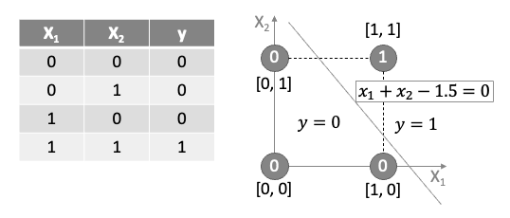
Decision Boundary
The perceptron learns a decision boundary: w₁x₁ + w₂x₂ + b = 0
Points above the line are classified as 1
Points below the line are classified as 0
For AND gate, only the point (1,1) should be above the line

Slide 18
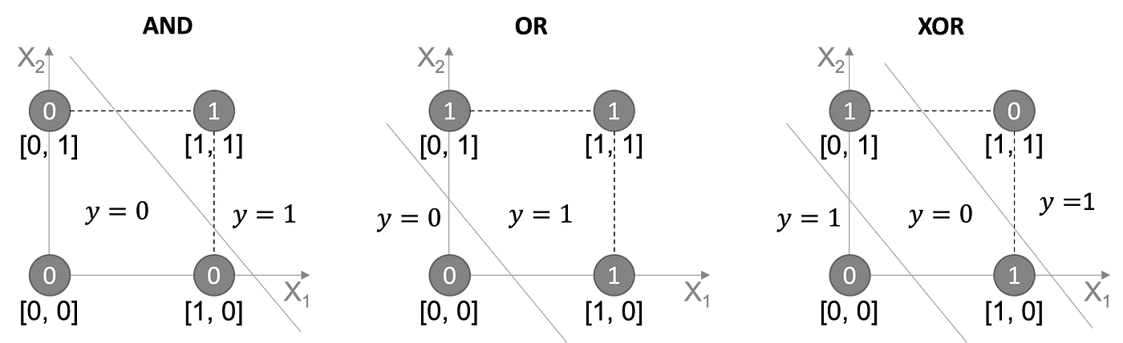
Limitations of Simple Perceptron
Can only learn linearly separable patterns
Cannot solve XOR problem (need multiple layers)
No probabilistic output
Simple update rule isn't suitable for complex problems

Slide 19
Introduction to Neural Networks
Multi-Layer Neural Network

Slide 20
The Multi-Layer Percecptron (MLP)
Limitations of the Perceptron: While useful for linearly separable problems, the single perceptron cannot solve complex problems like XOR classification, as demonstrated by Minsky and Papert in their 1969 book "Perceptrons.“
Enter the Multi-Layer Perceptron
The Multi-Layer Perceptron addresses the limitations of the single perceptron by introducing:
Multiple layers of neurons
Non-linear activation functions
More sophisticated learning algorithms

Slide 21
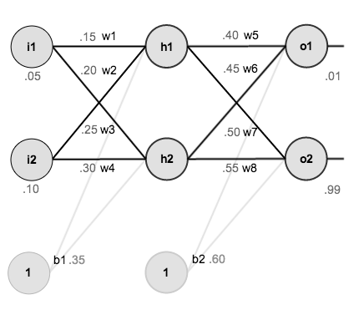
Structure of an MLP
Definition: An MLP is a class of feedforward artificial neural network that consists of at least three layers of nodes: input, hidden, and output layers.
Key Feature: Each neuron in one layer is connected to every neuron in the next layer (fully connected).
1. Input Layer
Receives the raw input features
One neuron per input feature
No computation occurs here; inputs are simply passed forward
2. Hidden Layer(s)
One or more layers between input and output
Each neuron in a hidden layer:
Receives inputs from all neurons in the previous layer
Computes a weighted sum
Applies a non-linear activation function
Passes the result to the next layer
3. Output Layer
Produces the final prediction or classification
Structure depends on the task:
Regression: Often a single neuron with linear activation
Binary classification: One neuron with sigmoid activation
Multi-class classification: Multiple neurons (one per class) with softmax activation

Slide 22
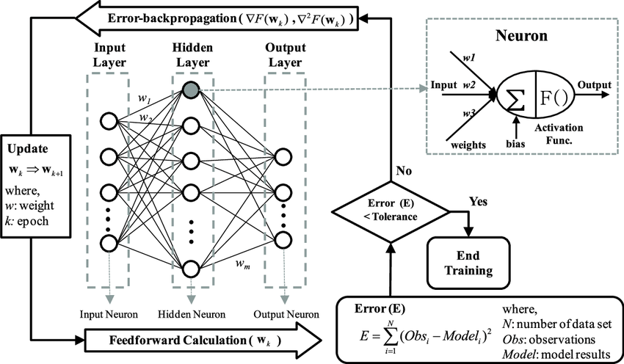
How Neural Networks Learn
Training Process:
Feed data into the network.
Compute the output using weights.
Compare the output with the correct answer (loss calculation).
Adjust weights using backpropagation & gradient descent to improve accuracy.
Loss Function: MSE for regression, Cross-Entropy for classification.
Optimization: Backpropagation + Gradient Descent (or Adam).

Slide 23
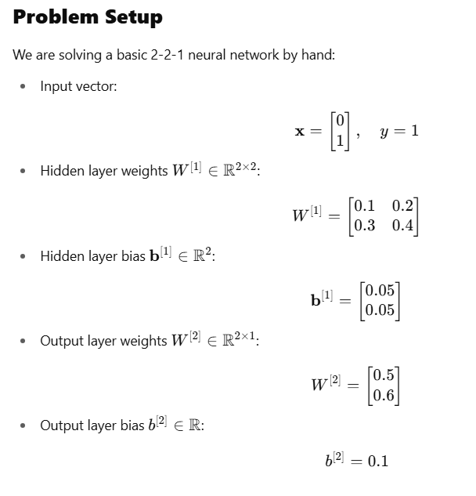
Manual Computation for One Forward-Backward Pass

Slide 24
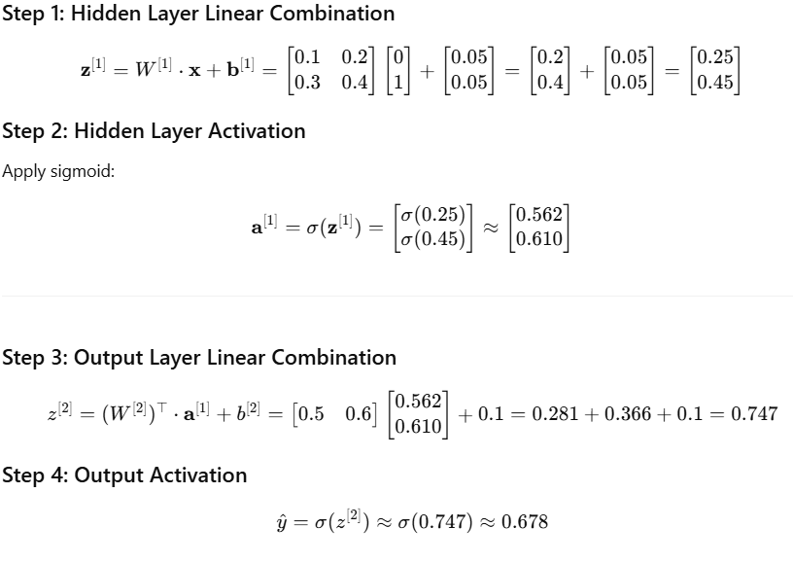
Forward Propagation

Slide 25
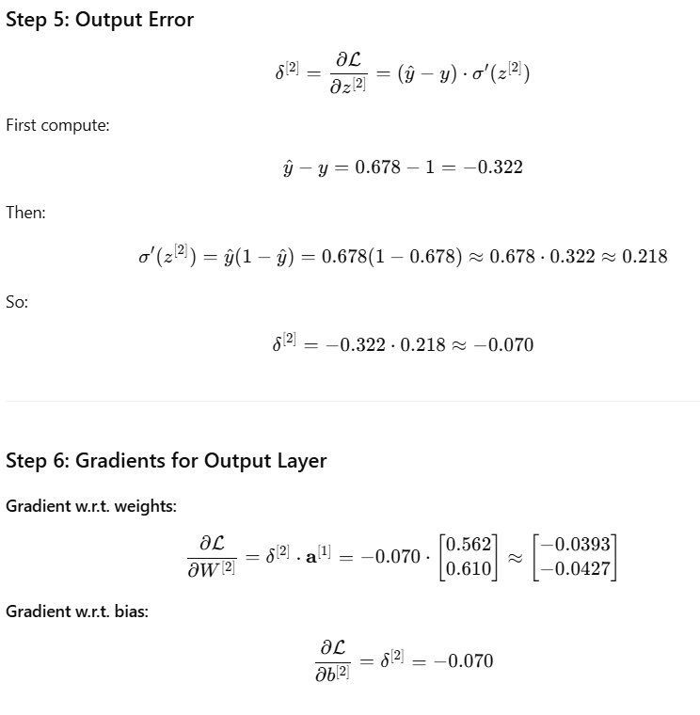
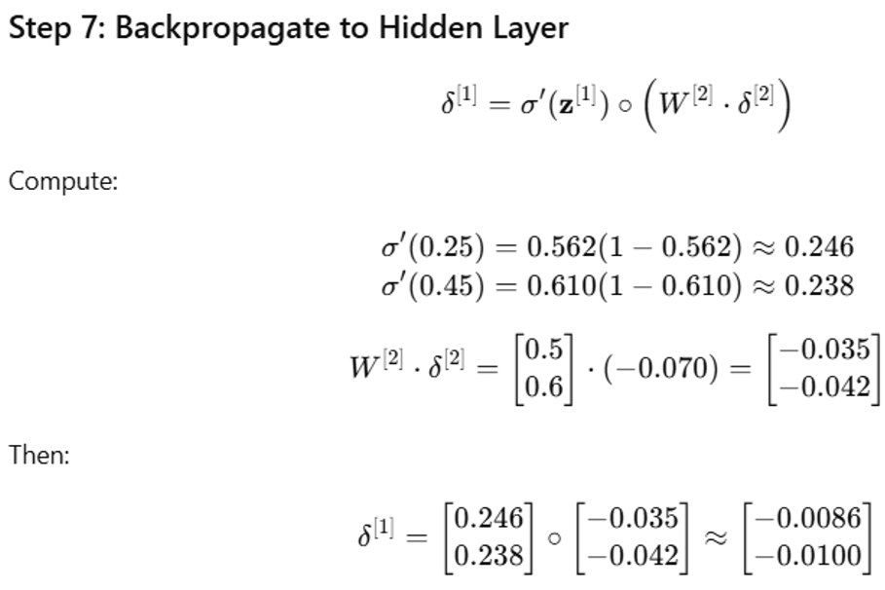
Backward Propagation

Slide 26
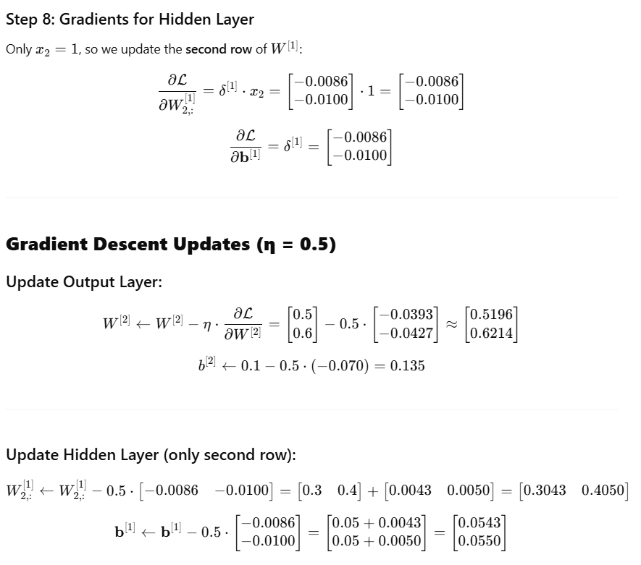
Backward Propagation

Slide 27
Introduction to Word Embeddings

Slide 28
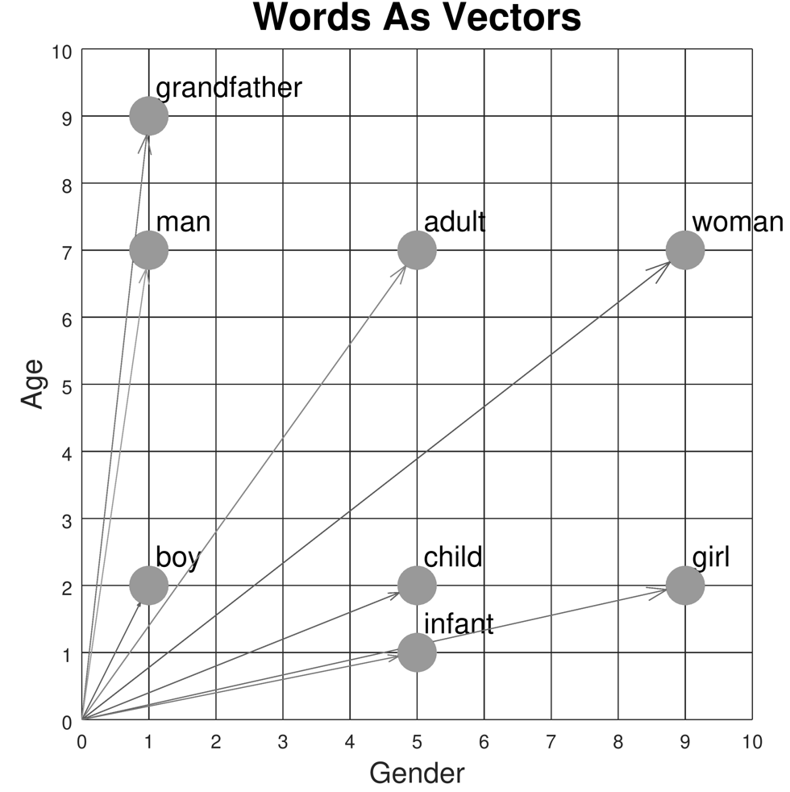
Introduction to Word Embeddings
Definition: Word embeddings are vector representations of words in a continuous vector space.
Purpose: Capture semantic and syntactic relationships between words.
Key innovation: Words with similar meanings have similar vector representations.
Foundation of modern NLP: Enable machines to understand relationships between words.

Slide 29
The Evolution of Word Representations
Traditional Methods (Pre-2013)
One-hot encoding: Sparse, binary vectors (dimension = vocabulary size)
Limitations:
No notion of similarity between words
Curse of dimensionality
No semantic information captured
Word | Dimension 1 (cat) | Dimension 2 (dog) | Dimension 3 (fish) | Dimension 4 (bird)
cat | 1 | 0 | 0 | 0
dog | 0 | 1 | 0 | 0
fish | 0 | 0 | 1 | 0
bird | 0 | 0 | 0 | 1

Slide 30
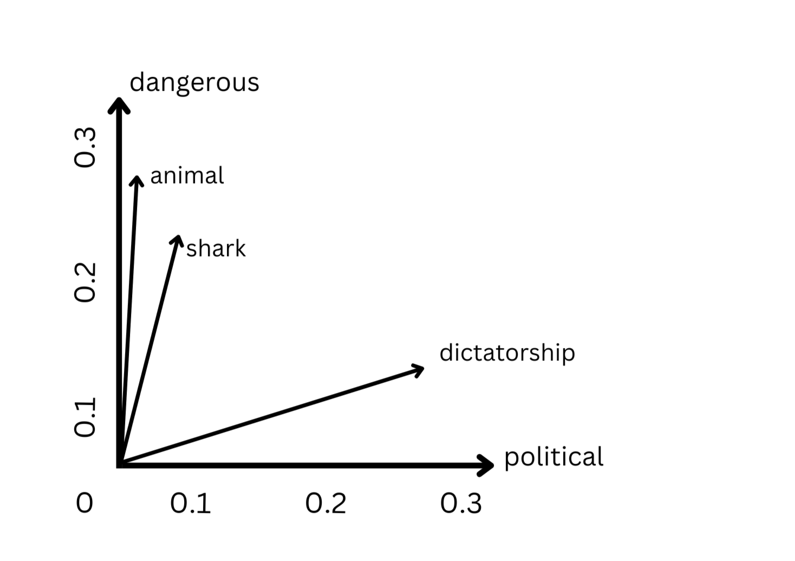
The Evolution of Word Representations
Problem: How do we represent meaning mathematically?
Solution: Distributional hypothesis - "You shall know a word by the company it keeps" (J.R. Firth, 1957)
Word | Dimension 1 (political) | Dimension 2 (dangerous)
shark | 0.05 | 0.22
animal | 0.03 | 0.25
dangerous | 0.07 | 0.32
political | 0.31 | 0.04
dictatorship | 0.28 | 0.15
Words are represented as dense vectors in a continuous vector space
Each dimension potentially captures semantic meaning
Similar words cluster together in the vector space
Semantic relationships are preserved (e.g., "shark" is closer to "dangerous" than "political")
Enables meaningful similarity measurements and analogies

Slide 31
Word Similarities
import numpy as np
from sklearn.metrics.pairwise import cosine_similarity
# Fake word vectors (3D for simplicity)
word_vectors = {
"king": np.array([0.8, 0.65, 0.1]),
"queen": np.array([0.78, 0.66, 0.12]),
"man": np.array([0.9, 0.1, 0.1]),
"woman": np.array([0.88, 0.12, 0.12]),
"apple": np.array([0.1, 0.8, 0.9]),
}
def similarity(w1, w2):
return cosine_similarity([word_vectors[w1]], [word_vectors[w2]])[0][0]
print("Similarity(king, queen):", similarity("king", "queen"))
print("Similarity(man, woman):", similarity("man", "woman"))
print("Similarity(king, apple):", similarity("king", "apple"))

Slide 32
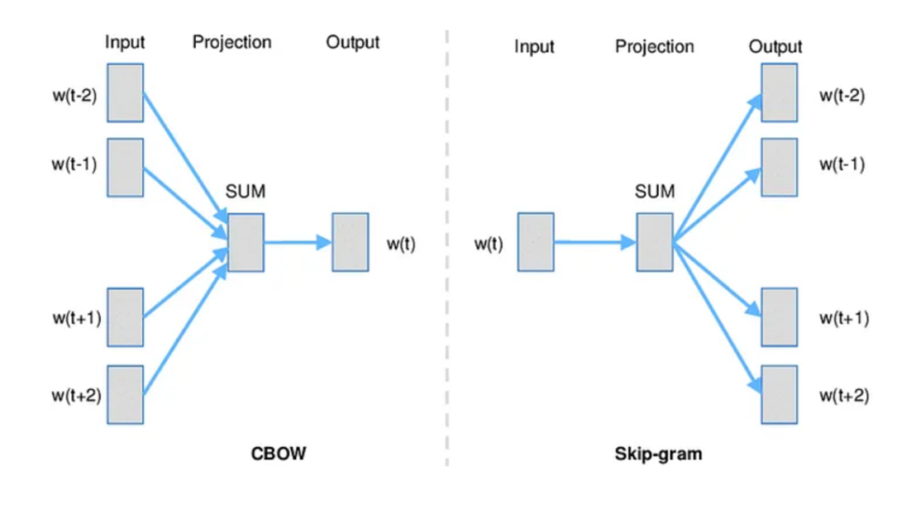
Word2Vec (Mikolov et al., 2013)
Key Innovation
Transformed NLP by creating dense vector representations through prediction-based models
Two Architectures
Continuous Bag of Words (CBOW):
Predicts target word from context words
Faster training, better for frequent words
Skip-gram:
Predicts context words from target word
Better for rare words, captures more semantic information
Characteristics
Typically 100-300 dimensions (vs. vocabulary size)
Linear relationships: king - man + woman ≈ queen
Efficient training through negative sampling
Limitations: Fixed vectors, one vector per word regardless of context

Slide 33
Real Embeddings
pip install spacy
python -m spacy download en_core_web_md
import spacy
nlp = spacy.load("en_core_web_md")
word1 = nlp("king")
word2 = nlp("queen")
print("Similarity:", word1.similarity(word2))

Slide 34
import gensim
from gensim.models import Word2Vec
import nltk
from nltk.tokenize import word_tokenize
nltk.download('punkt')
# Sample corpus
sentences = [
"Large language models are transforming business applications",
"Natural language processing helps computers understand human language",
"Word embeddings capture semantic relationships between words",
"Neural networks learn distributed representations of words",
"Businesses use language models for various applications",
"Customer service can be improved with language technology",
"Modern language models require significant computing resources",
"Language models can generate human-like text for businesses"]
# Tokenize the sentences
tokenized_sentences = [word_tokenize(sentence.lower()) for sentence in sentences]
# Train Word2Vec model
model = Word2Vec(sentences=tokenized_sentences,
vector_size=100, # Embedding dimension
window=5, # Context window size
min_count=1, # Minimum word frequency
workers=4) # Number of threads
# Save the model
model.save("word2vec.model")
# Find the most similar words to "language"
similar_words = model.wv.most_similar("language", topn=5)
print("Words most similar to 'language':")
for word, similarity in similar_words:
print(f"{word}: {similarity:.4f}")
# Vector for a specific word
word_vector = model.wv["business"]
print(f"\nVector for 'business' (first 10 dimensions):\n{word_vector[:10]}")
# Word analogies
analogy_result = model.wv.most_similar(positive=["business", "language"],
negative=["models"],
topn=3)
print("\nAnalogy results:")
for word, similarity in analogy_result:
print(f"{word}: {similarity:.4f}")

Slide 35
Practical Implementation: Word2Vec in Python
import gensim.downloader as api
from gensim.models import Word2Vec
import numpy as np
# Load pre-trained Word2Vec model
word2vec_model = api.load('word2vec-google-news-300’)
# Find similar words
similar_words = word2vec_model.most_similar('computer', topn=5)
print("Words similar to 'computer':", similar_words)
# Word analogies
result = word2vec_model.most_similar(positive=['woman', 'king'], negative=['man'], topn=1)
print("king - man + woman =", result)
# Train your own Word2Vec model
sentences = [["cat", "say", "meow"], ["dog", "say", "woof"]]
model = Word2Vec(sentences, vector_size=100, window=5, min_count=1, workers=4)
# Get vector for a word
cat_vector = model.wv['cat']
print("Vector for 'cat':", cat_vector[:5]) # Show first 5 dimensions

Slide 36
Practical Implementation: GloVe in Python
import numpy as np
from sklearn.metrics.pairwise import cosine_similarity
# Function to load GloVe vectors
def load_glove_vectors(file_path):
embeddings_dict = {}
with open(file_path, 'r', encoding='utf-8') as f:
for line in f:
values = line.split()
word = values[0]
vector = np.array(values[1:], dtype='float32')
embeddings_dict[word] = vector
return embeddings_dict
# Load pre-trained GloVe vectors
glove_vectors = load_glove_vectors('glove.6B.100d.txt')
# Calculate word similarity
def get_similarity(word1, word2, embeddings):
if word1 in embeddings and word2 in embeddings:
vec1 = embeddings[word1].reshape(1, -1)
vec2 = embeddings[word2].reshape(1, -1)
return cosine_similarity(vec1, vec2)[0][0]
return None
# Example usage
similarity = get_similarity('king', 'queen', glove_vectors)
print(f"Similarity between 'king' and 'queen': {similarity:.4f}")

Slide 37
Practical Implementation: BERT in Python
import torch
from transformers import BertModel, BertTokenizer
# Load pre-trained BERT model and tokenizer
tokenizer = BertTokenizer.from_pretrained('bert-base-uncased')
model = BertModel.from_pretrained('bert-base-uncased')
# Input text
text = "The quick brown fox jumps over the lazy dog."
# Tokenize input
inputs = tokenizer(text, return_tensors="pt")
# Get BERT embeddings
with torch.no_grad():
outputs = model(**inputs)
# Last hidden states contain contextual embeddings for each token
last_hidden_states = outputs.last_hidden_state
# Get embedding for the first token (after [CLS])
word_embedding = last_hidden_states[0, 1].numpy()
print(f"BERT embedding for 'The' (first 5 dimensions): {word_embedding[:5]}")
# Get embeddings for full sentence (CLS token)
sentence_embedding = last_hidden_states[0, 0].numpy()

Slide 38
GenAI and Large Language Models

Slide 39
Overview
What is generative AI
Large language models
Tokens
Tokens versus parameters
Prompt engineering
Zero-shot, one-shot and few-shot learning
Prompt guide
Generative AI systems examples
Large language models – getting started
OpenAI – ChatGPT
OpenAI tools
ChatGPT command types
ChatGPT - plugins
What about the students?
Office 365 Copilot – Windows 11 Copilot
What are our options?
What about Turnitin?
Practical use in learning and teaching
Assessment redesign for generative AI
Resources and further reading

Slide 40
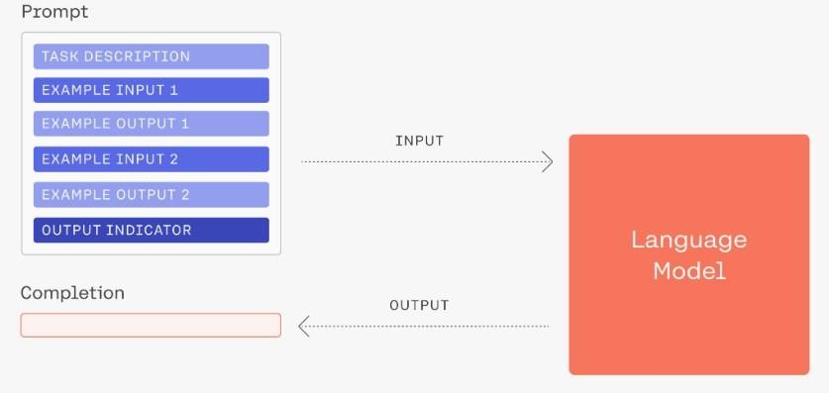
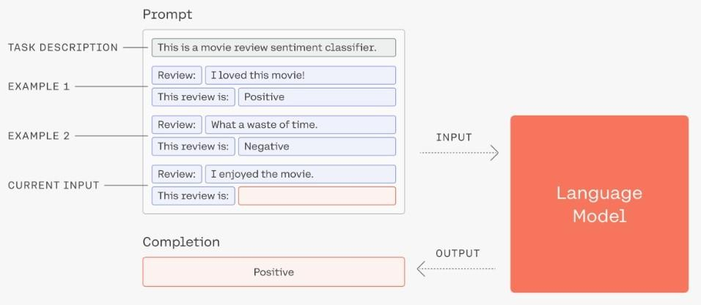
Generative AI (GenAI)
Type of Artificial Intelligence that leverages AI to generate content or data
Data can include text, images, audio, video, 3D models, code and video games
Typically created in response to prompts (prompt engineering)
Prompts are constructed inputs to language models to generate useful output
Usually given with examples - zero shot versus few shot learning
Source: docs.cohere.com https://docs.cohere.com/docs/prompt-engineering

Slide 41
Large language models
Type of machine learning model/algorithm
Performs variety of natural language processing (NLP) tasks
Learn, understand, and process human language efficiently
E.g., generate/classify text, answer questions conversationally
Uses hundreds of billions parameters

Slide 42
Large language models
Trained with large amounts of data
Based on neural networks (Transformers) that learn context and understanding through sequential data analysis
Uses self-supervised learning to predict the next token in a sentence, given the surrounding context
Process is repeated over and over until the model reaches acceptable level of accuracy
GPT-4 (Generative Pre-trained Transformer)

Slide 43
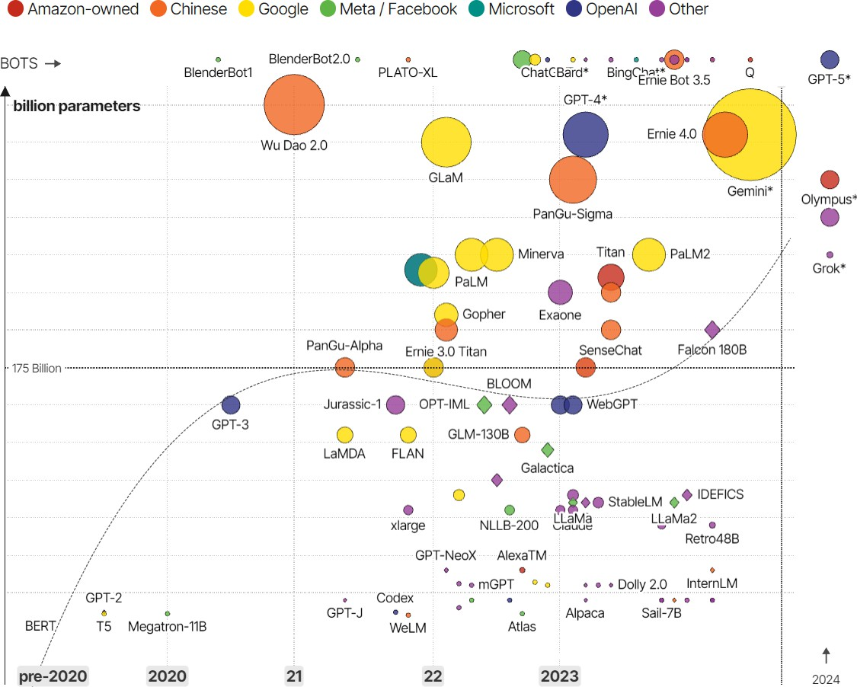
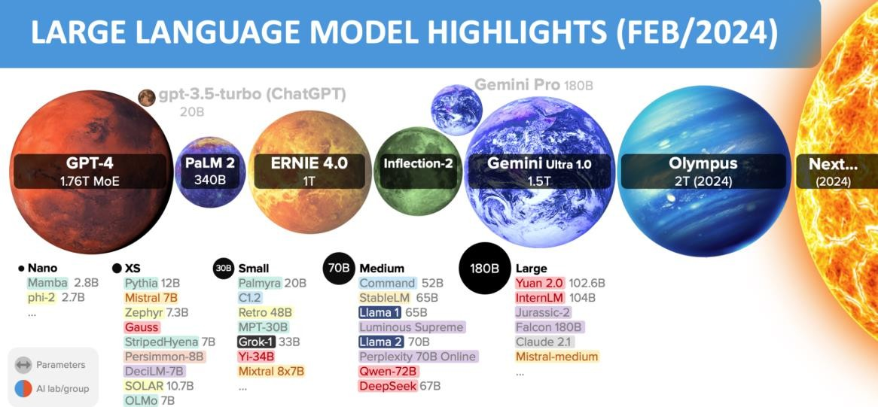
Large language models (LLM)
Source: https://lifearchitect.ai/models/
Source: informationisbeautiful.net
https://informationisbeautiful.net/visualizations/the-rise-of-generative-ai-large-language-models-llms-like-chatgpt/

Slide 44
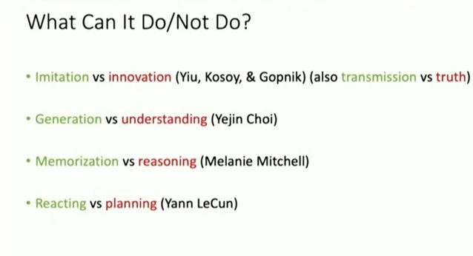
Large language models training
LLMs return similar patterns to data it is trained on (not thinking)
Wikipedia
Common crawl
Other sources
Large Language Model
Text output
Source: informationisbeautiful.net Generative AI +: Education https://www.youtube.com/@mit

Slide 45
Tokens
Basic units of text/code LLM uses to process or generate language
Can be characters, words, sub-words, segments of text or code
Tokens generally = ~4 characters of text for common English
¾ of a word – 100 tokens ~= 75 words
GPT models process text using tokens
Common sequences of characters found in text
Understands the statistical relationships between these tokens
Used to predict next token in a sequence of tokens

Slide 46
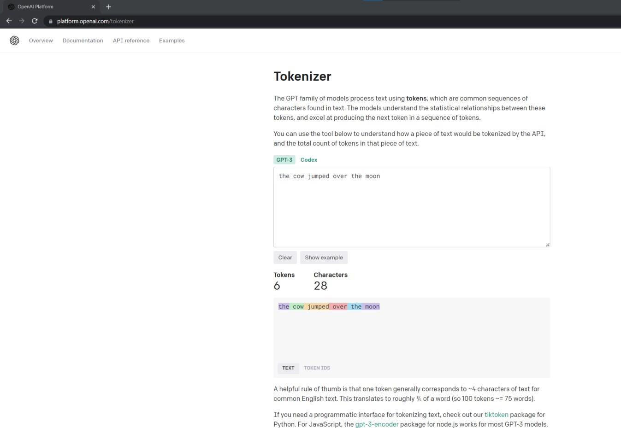
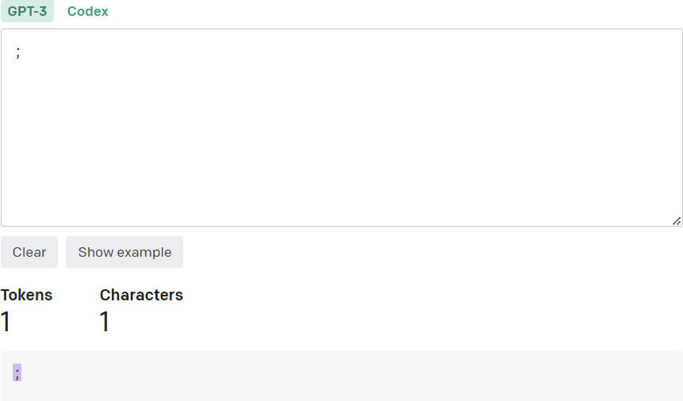
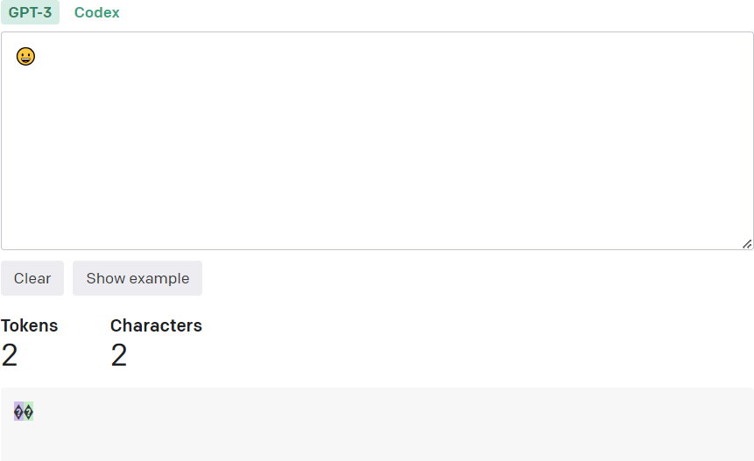
Tokens
https://platform.openai.com/tokenizer
https://lunary.ai/openai-tokenizer

Slide 47
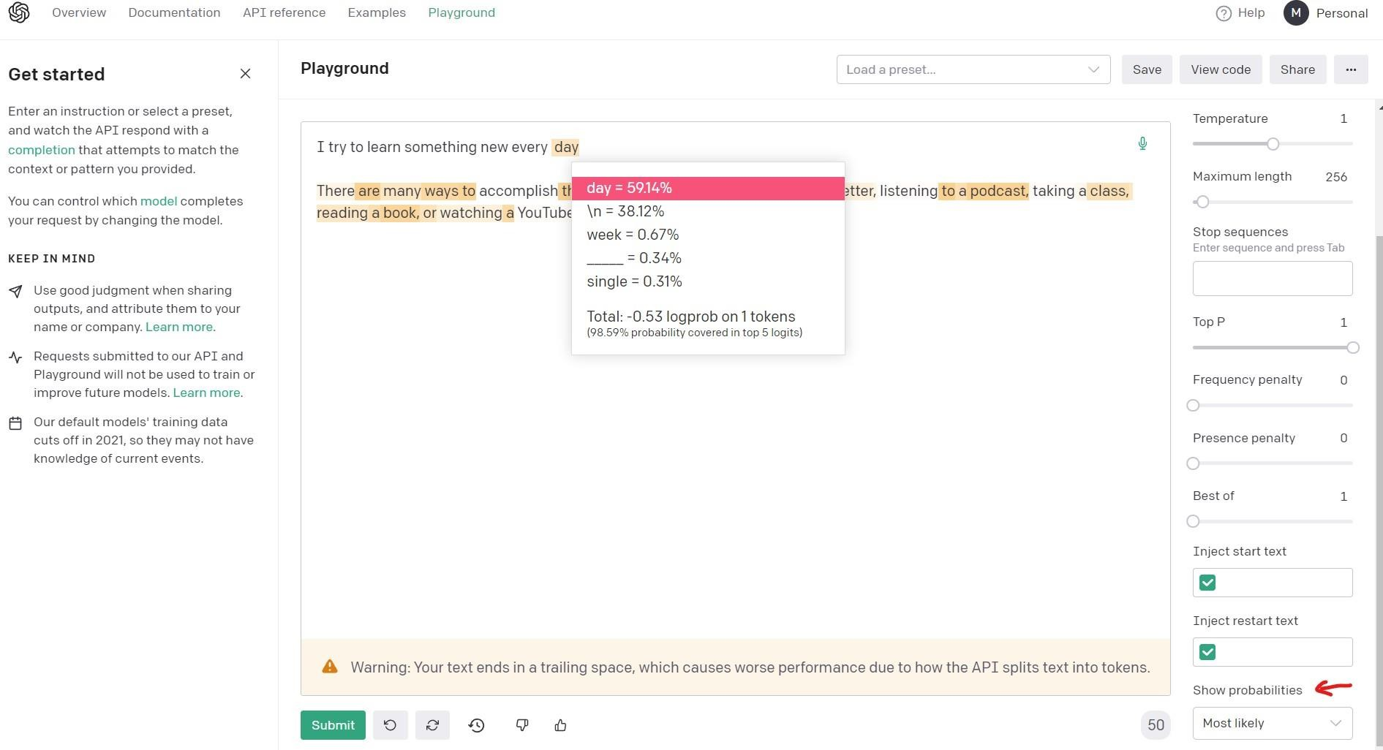
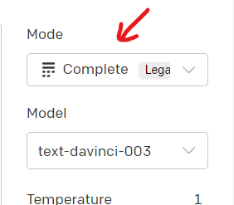
Tokens
https://platform.openai.com/playground

Slide 48
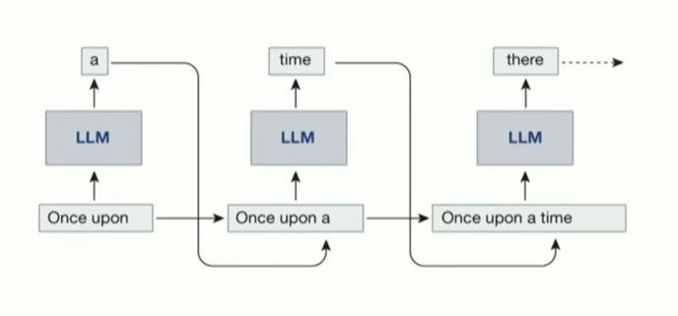
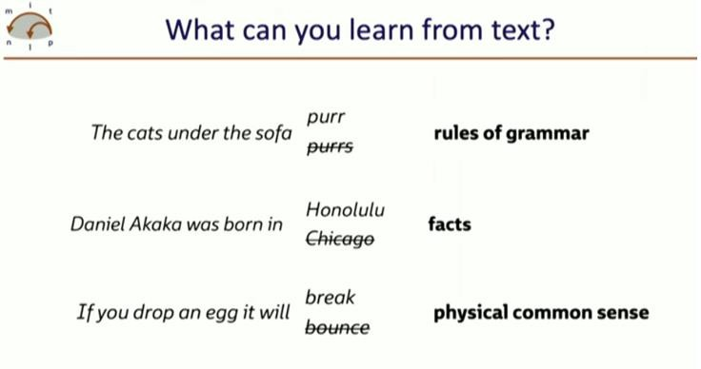
Tokens and structure
Source:
Shanahan M, McDonell K, Reynolds L. Role play with large language models. Nature. 2023 Nov;623(7987):493-498. doi: 10.1038/s41586-023-06647-8 Epub 2023 Nov 8. PMID: 37938776.

Slide 49
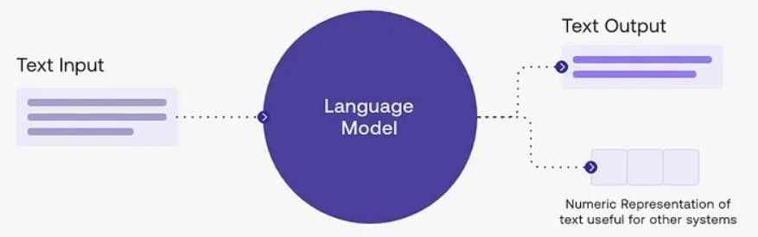
Tokens versus parameters
Large language model (LLM) context
Token is a basic unit of meaning e.g., word, punctuation mark
Parameters = numerical values that define model behaviour
Adjusted during training to optimize model's ability to generate relevant and coherent text
Large language model
Takes an input and produces a token
as an output
Source: medium.com
https://medium.com/@hmohamedhussain2004/what-is-an-llm-a0086882e585

Slide 50
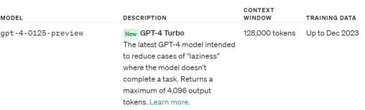
Why are tokens important?
Context window in large language models
Length of text model can process and respond to in given instance
Constraints length of prompt and response
Prompt (tokens) Response (sampled tokens)
gpt-4 8000 tokens
gpt-4-32k 32000 tokens
gpt-4 6000 words
gpt-4-32k 24000 words
Context window
ChatGPT-4 currently has a cap related to message frequency – 128,000 tokens
https://platform.openai.com/docs/models/gpt-4-and-gpt-4-turbo

Slide 51
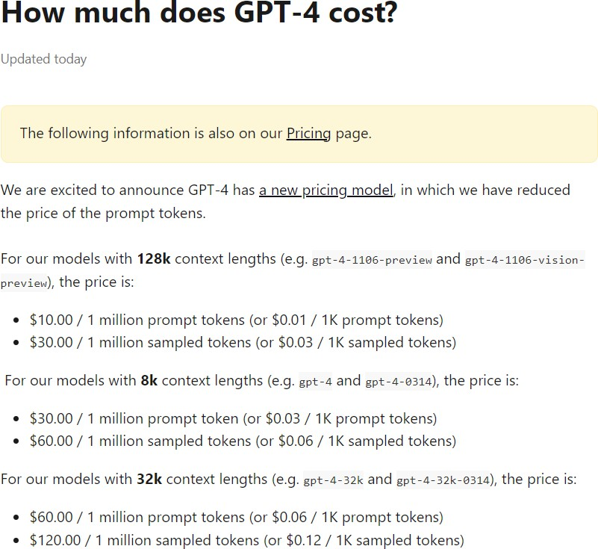
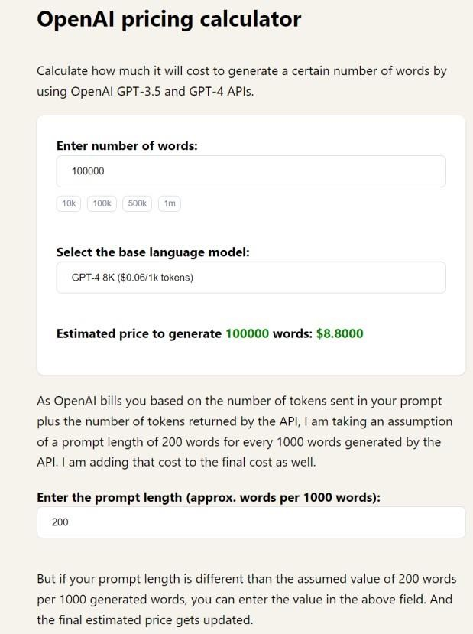
Cost is based on tokens used
https://help.openai.com/en/articles/7127956-how-much-does-gpt-4-cost
https://invertedstone.com/tools/openai-pricing/

Slide 52
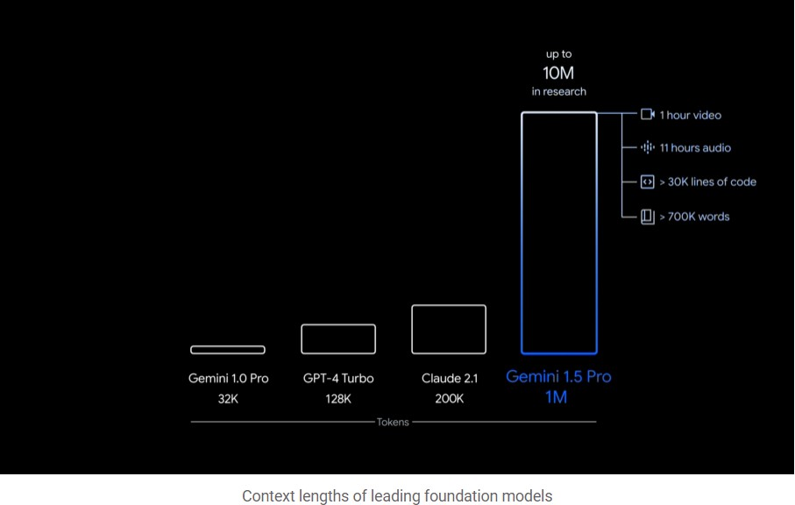
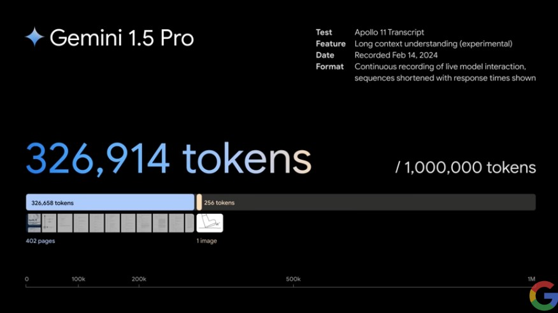
Gemini 1.5 - 1 million multimodal tokens
Complex reasoning about vast amounts of information
1.5 Pro can seamlessly analyze, classify and summarize large amounts of content within a given prompt. For example, when given the 402-page
transcripts from Apollo 11’s mission to the moon, it can reason about
conversations, events and details found across the document.
https://blog.google/technology/ai/google-gemini-next-generation-model-february-2024/#architecture

